Slide 1

Linear Algebra and its application in genetics
Aryan garg,
abhiram tilak
Shreyas adiga

Slide 2

INTRODUCTION
Linear Algebra is a highly important and versatile tool used in a vast number of fields such as economics, engineering and physics. In this presentation we will explore the applications of linear algebra in the study of genes and evolution.

Slide 3
index
Gene interaction
Gene expression
Prey predator model
Gene interaction helps to understand how different genes influence each other’s expression and impact an organism’s traits. It also discusses various types of epistatic gene interactions
Gene Expression mathematically analyses how Mendelian Genetics is used to predict the genotype and phenotypes of offspring.
STEM students received over $2 million dollars in grants
Disease susceptibility
Cpg island models
LOGISTIC MAPS
We do a few case studies on different types of genetic diseases and analyse a few of their pedigree trees and to quantify an future generation’s likelihood of developing that particular disease.
The CpG island model utilizes mathematical techniques to study and predict the presence and distribution of CpG islands, which are regions of DNA associated with gene regulation
Logistic maps are mathematical models that describe population dynamics and growth, commonly used to study complex systems exhibiting non-linear behaviour.
Pca and its applications
Principal Component Analysis (PCA) is a mathematical technique used to reduce the dimensionality of data while preserving its essential features

Slide 4
GEne expression
What IS GENE EXPRESSION ?
Gene expression refers to the process by which the information encoded in a gene is used to synthesize a functional gene product, such as a protein or RNA molecule.
Gene expression is a fundamental process in living organisms and is tightly regulated to ensure proper development, growth, and functioning of cells and tissues.
Transcription
Translation
GEne expression has 2 main processes:
Notes:
Definition

Slide 5
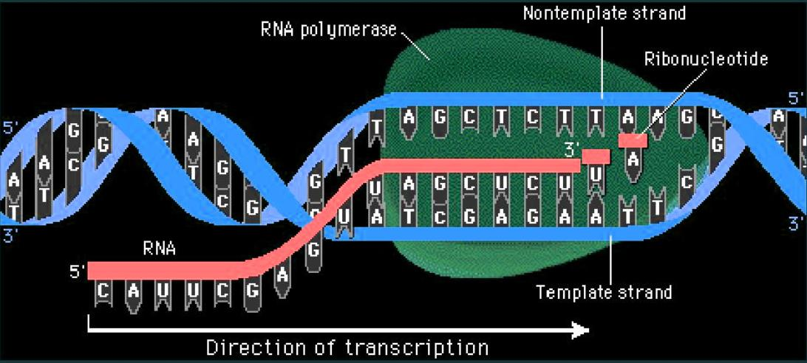
TRANSCRIPTION
GENE EXPRESSION
Figure:
The figure represents
transcription of DNA
by RNA polymerase
in 3’ to 5’ direction of
DNA and creates a new stand of
mRNA in 5’ to 3’
direction
Transcription is the process by which the information in a
strand of DNA is copied into a new molecule of messenger RNA (mRNA).

Slide 6
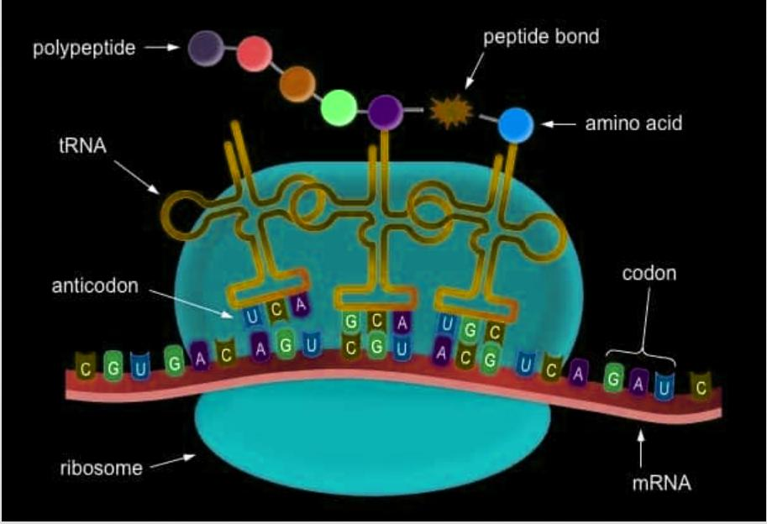
TRANSLATION
GENE EXPRESSION
T
Translation refers to the process by which the genetic information
stored in mRNA (messenger RNA) molecules is used to synthesize proteins.

Slide 7
Gene expression
Mendelian genetics
Mendel Genetics refer to the basic principles of inheritance first described by Gregor Mendel. Mendel gave three fundamental laws based on his experiments with pea plants
Law of segregation:
Each trait possesses two alleles which separate during gamete formation, with each gamete receiving only one allele
The alleles for different traits segregate and get sorted into gametes independently of one, leading to various combinations of traits in offspring
LAW of independent assortment:
LAW of dominance:
The law states that in a heterozygous individual the dominant allele is expressed in the phenotype.
Notes:
DOMINATION punnet square image

Slide 8
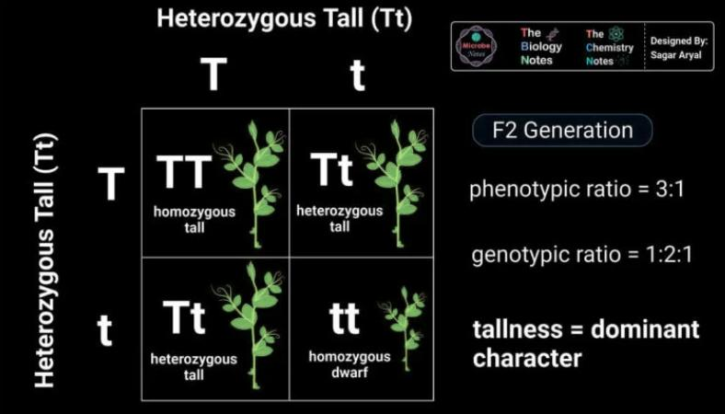
Gene expression
LAw of domination
Figure:
Punnet square representation
of Law of Dominance
Notes:
DOMINATION punnet square image

Slide 9
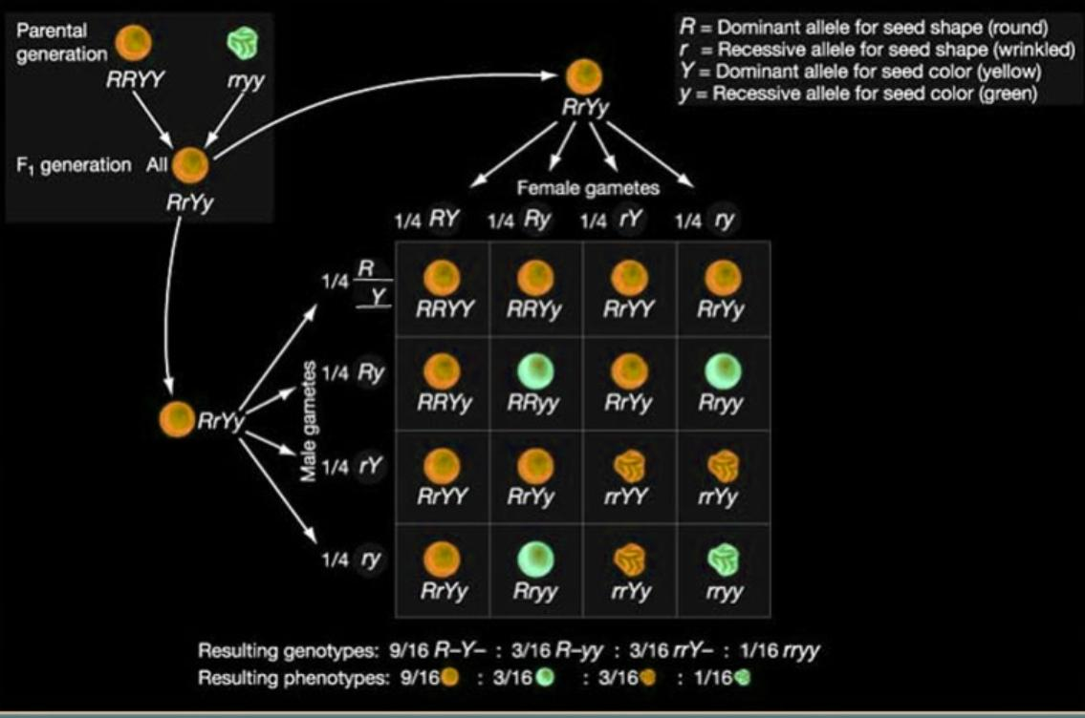
GENE expression
LAw of Independent assortment
Figure:
Punnet square representation
of Law of Independent Assortment
Notes:
DOMINATION punnet square image

Slide 10
GENE Interactions
TYpes of gene interactions
Gene-gene interactions, also known as genetic interactions, occur when the effect of
one gene on a trait or phenotype is modified by another gene or set of genes.
Additive interactions
Multiplicative interactions
Epistatic interactions
Notes:
DOMINATION punnet square image

Slide 11
DiSEASE SUSCEPTIBITLITY
TYpes of gene interactions
The chance or vulnerability of an individual to contract a specific disease is referred
to as disease susceptibility. It is affected by a number of lifestyle, environmental, and hereditary variables.
We will mostly look at two of the diseases relevant to our discussion:
Haemophilia
Sickle cell Anemia
Notes:
DOMINATION punnet square image

Slide 12
DiSEASE SUSCEPTIBITLITY
CASE Study: Haemophilia
Hemophilia is an inherited bleeding disorder characterized by a deficiency or abnormality in certain clotting factors in the blood.
Pedigree analysis is a technique used in genetics to examine how traits or diseases are passed down across families over many generations. It entails creating a family tree or pedigree chart that shows the connections between family members and chronicles the passing down of traits or diseases.
Notes:
DOMINATION punnet square image

Slide 13
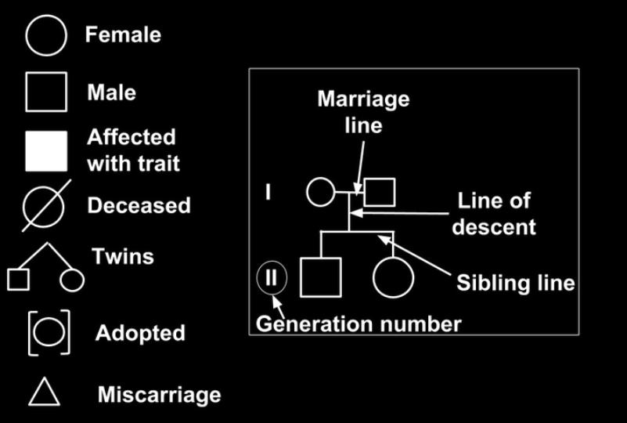
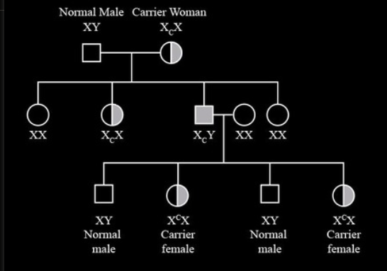
CASE Study: Haemophilia
Figure left: Pedigree representation and legend used
Figure right: Pedigree chart of Haemophilia
for various cases and 2 generations

Slide 14
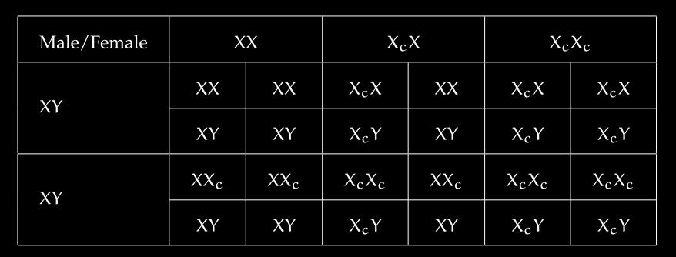
CASE Study: Haemophilia
Table: Genotypes of Offsprings in Haemophilia

Slide 15
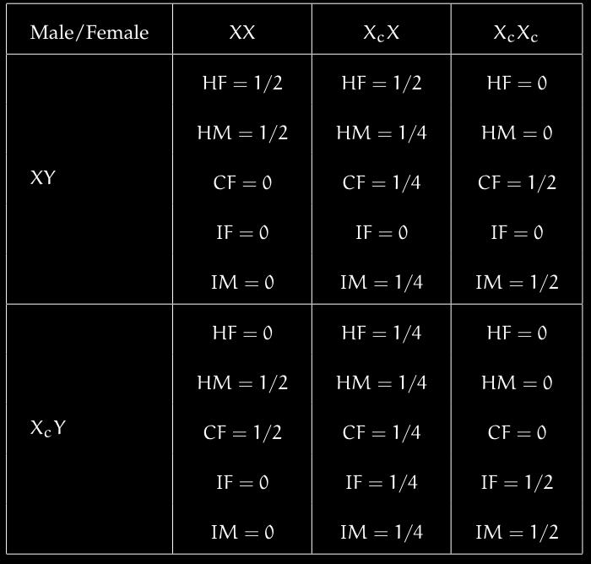
CASE Study: Haemophilia
Table: Probabilities of Disease Susceptibility in Offsprings during Haemophilia
Abbreviations used:
H - Healthy,
C - Carrier,
I - Infected,
M - Male,
F - Female

Slide 16
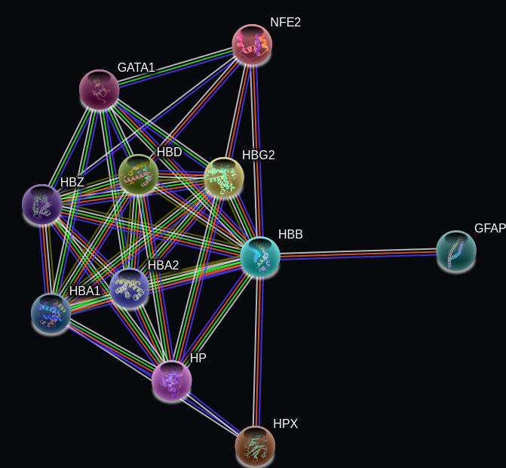
Sickle Cell Anemia
Sickle cell anemia is inherited in an autosomal recessive manner, that is, both
copies of the HBB gene must carry the mutation for the disease to manifest.
We can see the gene-gene network of HBB gene below.

Slide 17
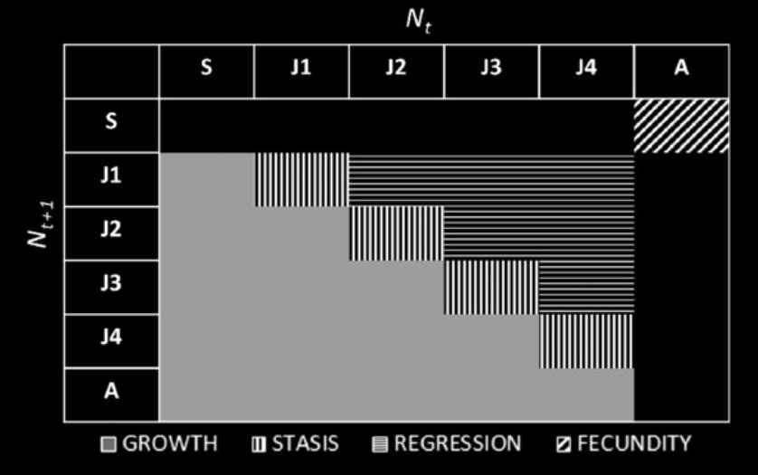
MARKOV CHAINS
A Markov chain is a mathematical system which shows the probability of transition between different states. These probabilities can be represented as a transition matrix.
There are two main components of a markov chain
The transition matrix
The initial state vector
figure:
above is a geneRALIZED VERSION OF A TRANSIITON MATRIX

Slide 18
MARKOV CHAINS
STEADY STATES
The steady state vector, also known as the equilibrium distribution, represents the long-term probabilities of being in each state in a Markov chain. It can be calculated by solving the equation π = πP, where π is the steady state vector and P is the state transition matrix.

Slide 19
MARKOV CHAINS
STEADY STATES
MATHEMATICAL DEFINITION OF STEADY STATES
Let A be a stochastic matrix. Then:
1 is an eigenvalue of A.
If λ is a (real or complex) eigenvalue of A, then |λ|≤1.
In fact, for a positive stochastic matrix A, one can show that if λB=1 is a (real or complex) eigenvalue of A, then |λ|<1. The 1-eigenspace of a stochastic matrix is very important.
THEREFORE Definition:
A steady state of a stochastic matrix A is an eigenvector w with eigenvalue 1, such that the entries are positive and sum to 1.

Slide 20
MARKOV CHAINS
APplication of markov chains
Mendelian genetics
Leslie matrix ( population analysis )
Cgp islands
Prey predator model

Slide 21
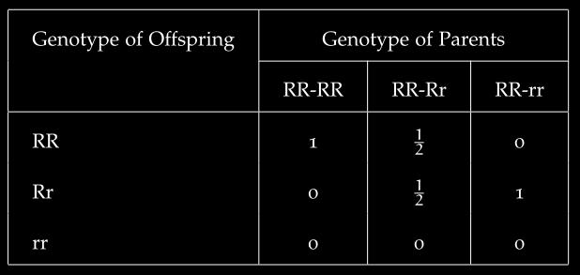
MEndelian genetics
CASE STUDY:
Consider this table which denotes the fraction of all offsprings if one parent’s geno-
type is homozygous dominant and the other parent is anything
Notes:
Consider this table

Slide 22
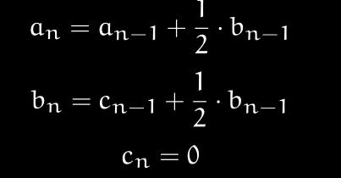
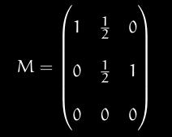
MEndelian genetics
CASE STUDY:
We will represent this information as a 3 × 3 stochastic matrix as follows.
Let a_{n} ,b_{n} , c_{n} denote fraction of TT,Tt and tt plants in n^{th} generation . Thus , we have the following recursive equations, representing the n^{th} generation.
Notes:
Consider this table

Slide 23
MEndelian genetics
CASE STUDY:
Consider this table which denotes the fraction of all offsprings if one parent’s geno-
type is homozygous dominant and the other parent is anything
Notes:
Consider this table

Slide 24
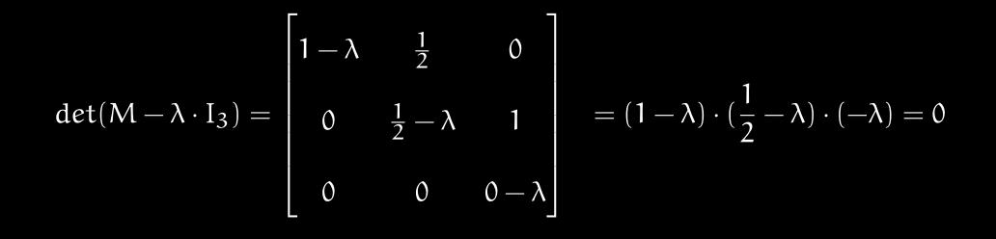
MEndelian genetics
CASE STUDY:
Thus, we get;
X_{n} = M^{n} X₀
To compute this for large n’s , we diagonalize M; let λ be a eigenvalue of M and be its corresponding eigenvector. Then,
So, the eigenvalues are 1, 1/2 and 0
Notes:
Thus we get and then M^n thing and then solutions of eigen values

Slide 25
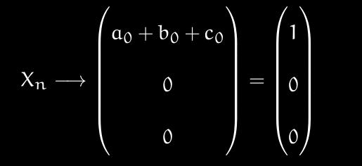
MEndelian genetics
CASE STUDY:
We get
M = P · D · P⁻¹,
where D is the diagonalized matrix and P is obtained by combining the 3 eigenvectors of M
X_{n} = M_{n} ·X₀ = P · D^{n} · P⁻¹· X₀
Thus , we can predict the genotypic population density in the n^{th} generation .
We also note that when n → ∞:
Notes:
Thus we get and then M^n thing and then solutions of eigen values

Slide 26
Leslie Matrix
Definition
In applied mathematics, the Leslie matrix is a discrete, age-structured model of population growth that is very popular in population ecology.
The Leslie matrix (also called the Leslie model) is one of the most well-known ways to describe the growth of populations (and their projected age distribution), in which a population is closed to migration, growing in an unlimited environment, and where only one sex, usually the female, is considered

Slide 27

Leslie Matrix
MATRIX REPRESENTATION
Figure:
The f_{i} represents birth rate of each class
The s_{i} represent the survival rate of each class
x_{i} represents the population of each class in a give state

Slide 28
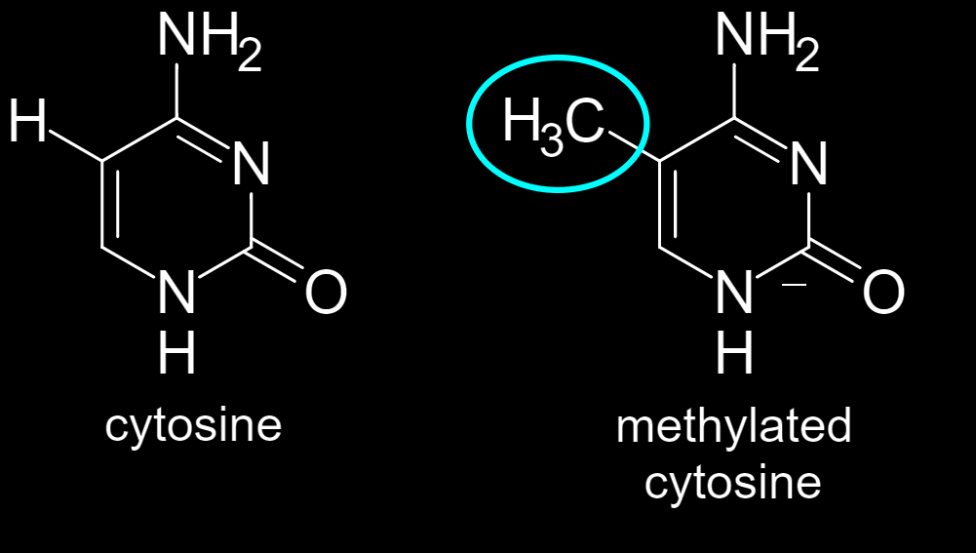
CPG Island (PRE)
DNA METHYLATION
DNA Methylation is the process of adding a methyl group (-CH₃) to the DNA molecule this is an epigenetic process i.e the change is reversible and doesn’t change the DNA sequence however epigenetics is useful to observe the effects of environment on the functioning of genes.

Slide 29
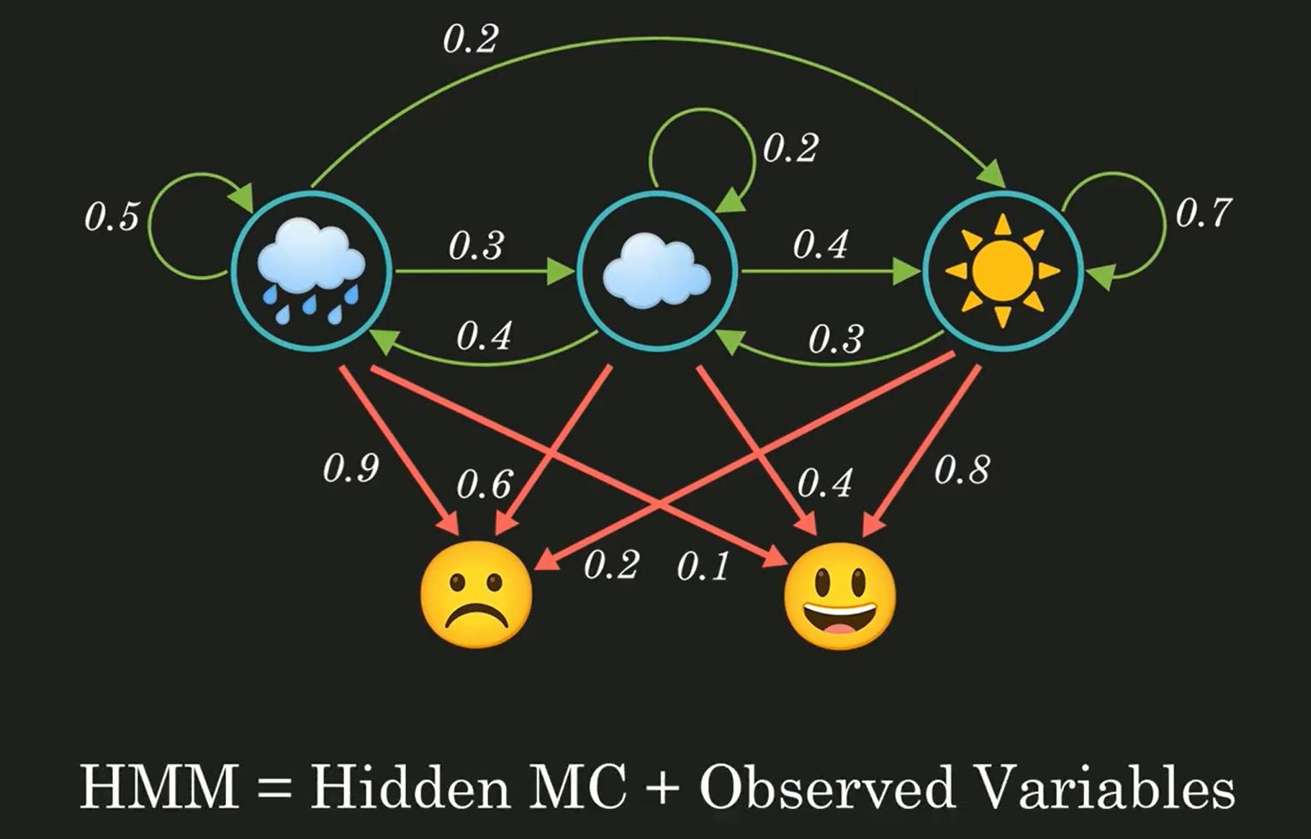
CPG Island (PRE)
Hidden Markov Models ( HMm )
An HMM consists of two types of variables: hidden states and observations.
The hidden states are the underlying variables that generate the observed data, but they are not directly observable.
The observations are the variables that are measured and observed.

Slide 30
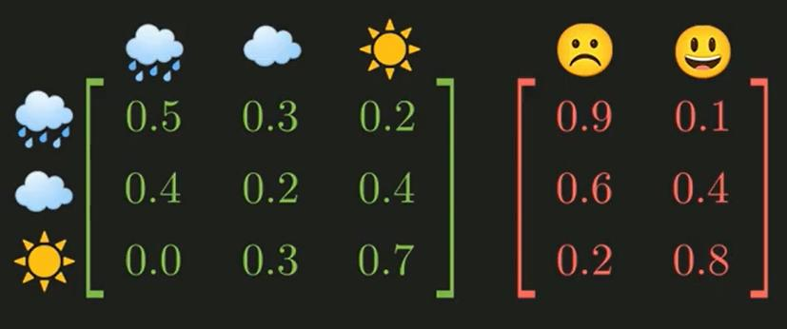
CPG Island (PRE)
Hidden Markov Models ( HMm )
Transition matrix Emission Matrix

Slide 31


CGP Island and simulation
DEFINITION:
CpG islands (or CG islands) are regions with a high frequency of CpG sites.
Though objective definitions for CpG islands are limited, the usual formal definition is a region with at least 200 bp (bond pairs), a GC percentage greater than 50
Our simulation:
Methodology
REsults and interpretation

Slide 32
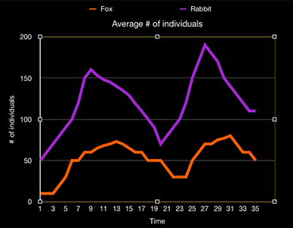
PREY- PREDETOR MODEL
LOTKA VOLTERRA MODEL
The Lotka-Volterra model also known as the prey-predator model, is a set of differential equations that describes the interactions between predator and prey populations in an ecological system.
FIGURE:
The population cycles of three prey and predators is shown as we can see an increase in prey population
leads to the increase of predator population, and as predator population increases there is a decrease in prey population due to predation.
Thus, we see that availability of food and resources which boost prey populations leading to predation and increase in predator population are important factors affecting the population size of these two species.

Slide 33
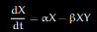
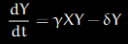
Prey-predator model
LOTKA VOLTERRA equations
Here :-
X = the number of prey
Y = the number of predators
α, β, γ, δ are positive real constants
$$\frac{ⅆx}{ⅆt}$$ and $$\frac{ⅆy}{ⅆt}$$ are the instantaneous rates of prey and predators respectively.

Slide 34
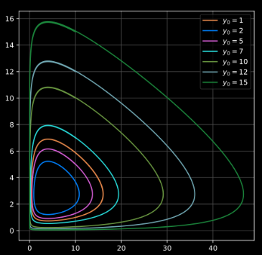
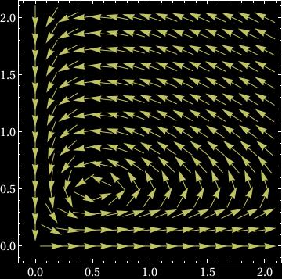
PREY-PREDATOR model
VECTOR FIELD PLOT
FIGURE:
The vector field plot for the model shows us the instantaneous change and flow or movement of the prey and predator populations in the phase
Figure:
Here we observe the phase plot and the vector field plot for the Lotka-Volterra Model.

Slide 35
PRINCIPAL COMPONENT ANALYSIS
Principal component analysis(PCA)
PCA stands for Principal Component Analysis. It is a dimensionality reduction technique commonly used in machine learning and data analysis. The goal of PCA is to transform a high-dimensional dataset into a lower-dimensional space while preserving the most important patterns and relationships in the data.
We can calculate the PCA component by following these steps:
Centre the data matrix by calculating the mean of each column and subtracting it from the elements of the column
Calculate the covariance matrix of the matrix.
$$cov\left(x,y\right)= \frac{1}{2}Σ\left(x−\overline{x}\right)\left(y−\overline{y}\right)$$
Calculate the eigenvectors and eigenvalues of the covariance matrix and sort the eigenvalues in descending order
Select the top k eigenvectors corresponding to the sorted eigenvalue matrix where k is the number of desired dimensions.
Transform the data matrix into a lower dimensional result matrix by multiplying it with the selected eigenvectors.

Slide 36
PRINCIPAL COMPONENT ANALYSIS
Principal Component Analysis is a very useful tool in genetic analysis due to the large number of variables in gene expression dataset and helps identify the variables which cause the most variation in the data, this PCA also reduces the dimensionality of the dataset. This makes the data easier to visualize and analyse.
PCA is used to capture global immune response patterns by using it on data obtained from measuring IgM (A type of antibody which is initially produced by the immune system, it is the dominant antibody in primary immune responses) and IgG (The most common type of antibody) by using an ELISA assay which is a commonly used laboratory test to detect antibodies in the blood, this gives a multivariate statistic which can be analysed using PCA
PCA is also used to in the analysis of genetic variation across different demographics, ethnicities and geographical location. Isolation and migration of different groups of individuals lead to slight genetic variations between them however due to the vast amount of processes which can cause these variations it is a monumental task to infer which ones cause the most variation. By using PCA we can get a summary of the data and identify the processes which produce the most variation.

Slide 37
Logistic MAPS
Logistic Maps are mathematical models that describe the behaviour of a population over time. The logistic map is a discrete time system which links the population at one time step to the population size at the next step.
$$x_{n+1}=rx_{n}\left(1−x_{n}\right)$$
The parameter r can have different values and the population behaves according to it. For certain values of "r", the population size may converge to a stable value or oscillate between a few values. However, as the parameter "r" increases, the logistic map can exhibit more complex and chaotic dynamics

Slide 38
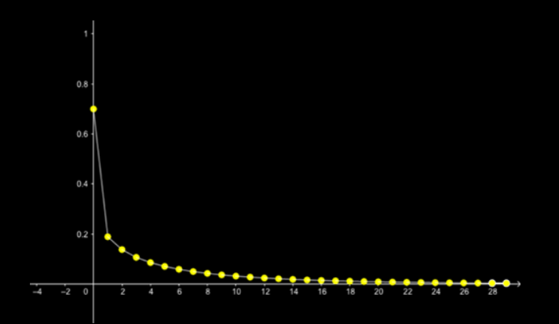
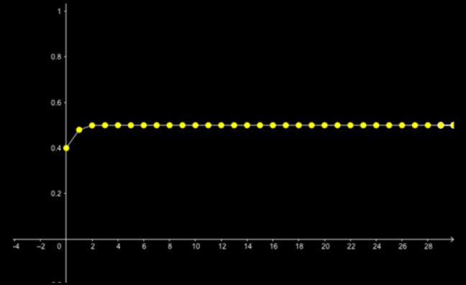
LOGISTIC MAPS
POPULATION DYNAMICS
Logistic Maps can be used to observe the population dynamics in a system by changing the value of the parameter r (0 <= r <= 4).
By taking an example of 100 guppies in a tank and sweeping the values of r and taking different values of x which is the initial proportion of the number of guppies and we get the following plots:-
r = 0.9 and x = 0.7
We observe that the population declines slowly and eventually dies out.
r = 2 and x = 0.4
We observe that the population eventually steadies.

Slide 39
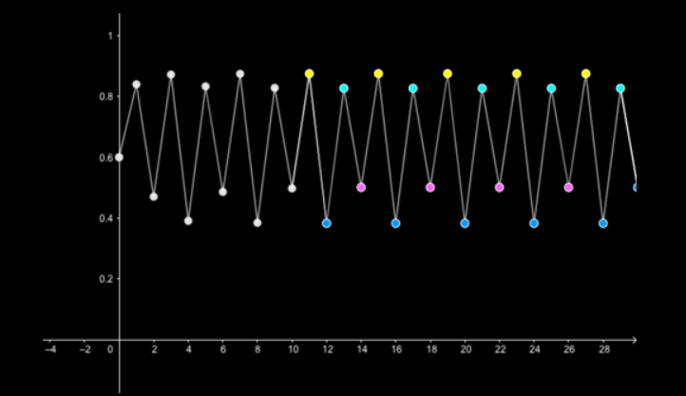
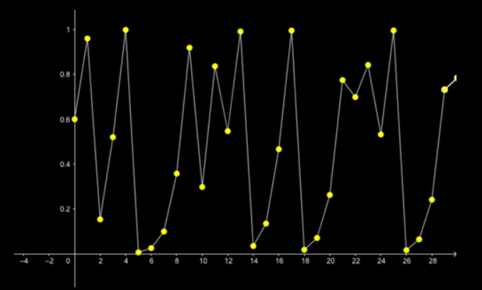
LOGISTIC MAPS
POPULATION DYNAMICS
By taking the r value through 3 we observe a periodic effect on the population cycle, on further increasing the value of r till approximately 3.57 the cycle becomes very erratic and difficult to predict.
r = 3.56995 and x = 0.6
We observe that the population cycle is neither steady and nor periodic.
r = 3.5 and x = 0.6
We can observe that the population cycles periodically.

Slide 40

Thank you
Abhiram Tilak
abhiram.potula@research.iiit.ac.in
Aryan Garg
aryan.garg@students.iiit.ac.in
Shreyas Adiga
— shreyas.adiga@research.iiit.ac.in

